Slide 1
MLSA Internship Full Stack Web Development
Name – Shivam Tyagi
Branch – CS
Roll no – 2200290120161
Year - 3

Slide 2
Introduction Of Internship
This internship teaches fundamental concepts and tools used in full stack development.
Gives a hands on experience and practical experience by giving projects on real world.
In this whole journey , learned many new technologies and tools such as github , etc.

Slide 3
Project 1 : To Do Web App (EASY)
A web app providing user a interface that is easy to understand.
In this user can add or remove task as per its need and manage them.
Html, Css, Js are the technologies used in this project.
Fundamental knowledge on JS core concepts like EventListener, DOM, loops , etc.

Slide 4
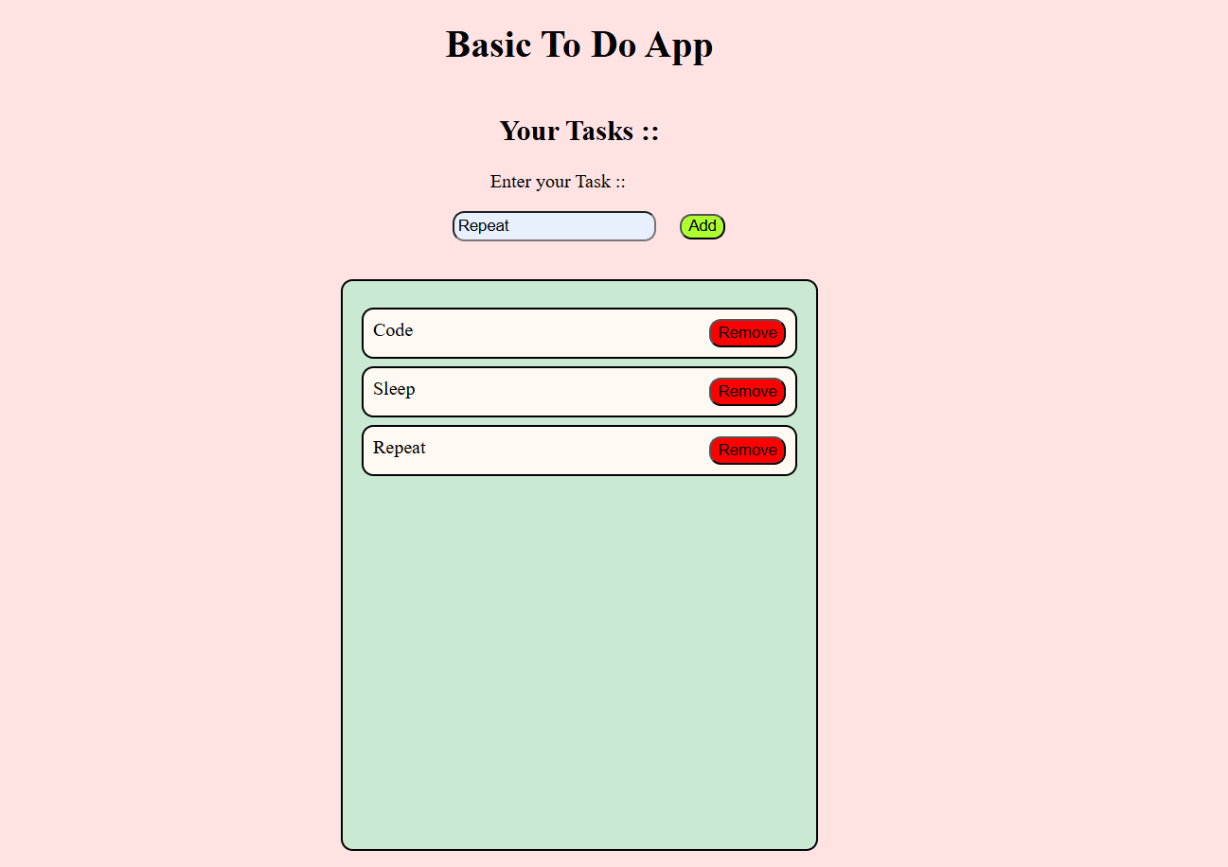
User Interface

Slide 5
Technologies Used
STRUCTURE : HTML is used for giving the overall structure to web app.
STYLING : CSS is used for styling.
WORK : JS is used for making it working where buttons do some work on click.

Slide 6
Project 2 : Weather Web App (Intermediate)
A Web app provides real time information of the place which user provides as an input.
Real time project , use API for the real time data.

Slide 7
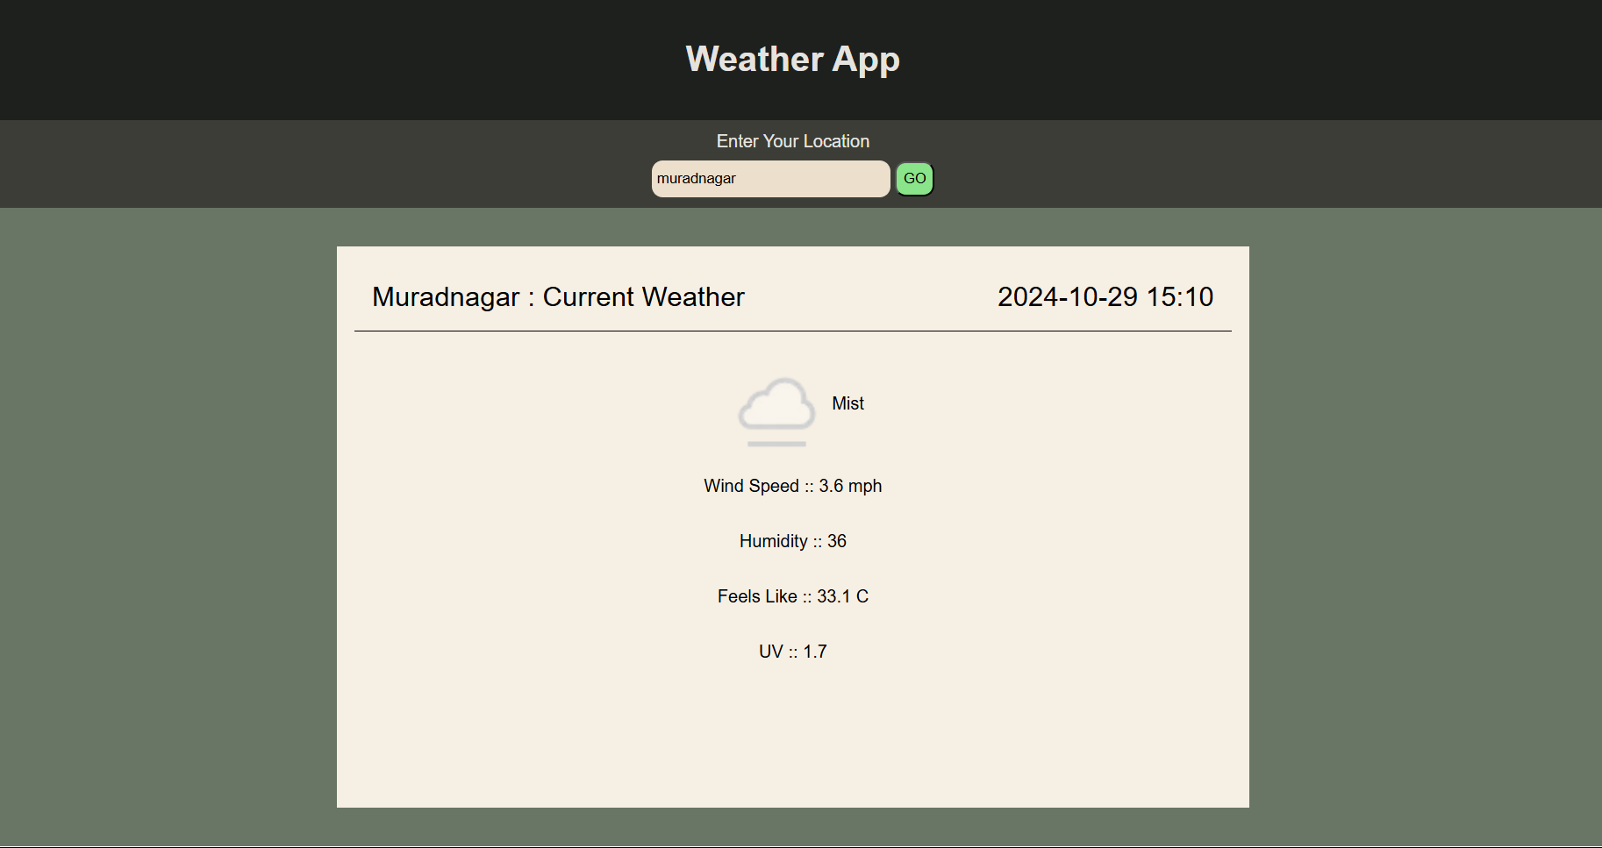
User Interface

Slide 8
Technologies Used
API : For getting real time data from other site or server.
AXIOS : For fetching and parsing the data in JS and using it for our work we use axios method.

Slide 9
Conclusion
Gives a core , fundamental and practical knowledge through projects.
A good mentorship support for any doubt.
Developed and learn the new skills of full stack development.

